Slide 1

- Abdul Saboor Hamedi
- M.A Thesis Defense
- UIII - Universitas Islam Internasional Indonesia

Slide 2
Women's Education in Afghanistan: Activist, Taliban, and Public Views

Slide 3
Outlines
01
Introduction
Literature Review
Hypothesis
Argument
02
Methodology
Data Collection Data Cleaning
Labeling Data
03
04
Find
Conclusion

Slide 4
Introduction
Main Focus
This study investigate women's education from three different views, namely: Activists, the Taliban and public views
Benefit
Research indicates that women who receive education are more likely to have expanded opportunities, particularly in non-farm sectors (Anderson et al., 2021).
Barriers
Women in patriarchal and conservative countries like Afghanistan face significant barriers to education, limiting their daily lives and access to public activities.

Slide 5
Research Problem
Research Question
Research Objective
Significant of study
What are the views of activists, Taliban, and the public regarding women's education in Afghanistan, and how does gender influence activists' views on the topic?
Uncovering gender dynamics: Examining tweets to understand cultural elements affecting women's education.
Amplifying marginalized voices: Giving voice to underrepresented communities through social media analysis.
Advancing gender equality: Using Twitter to identify barriers and promote inclusive education environments.
Views of activists, the Taliban, and the public sheds light on barriers to education for Afghan women.
This study investigates women's education in Afghanistan through the views of activists, the Taliban, and the public, considering the influence of gender norms and the varying viewpoints of different groups.

Slide 6
Literature Review
Education is a powerful tool in improving women's socio-economic prospects." (Anderson et al., 2021).
Activists with solid education backgrounds stand for women's education and against inequality." (Lyytikäinen, 2013).
Activism raises awareness of societal power structures and social inequities." (Luguetti & Oliver, 2020).
Education empowers women and promotes gender equality. Activism in various domains plays a crucial role in driving social change and challenging power structures.

Slide 7
Continue…
Activist African American women teachers in Harlem during the 1930s-1950s played a vital role in education and social reform (Johnson, 2004).
Male activists at Lakshmi Ashram viewed education as a means to improve women's economic status and independence (Klenk, 2010).
Female activists at Lakshmi Ashram saw education as a tool to challenge gender inequality and empower women (Klenk, 2010).

Slide 8
Continue…
Activists had differing strategies: females aimed to challenge social norms, while males focused on financial support (Klenk, 2010).
Female activists faced opposition, while male activists gained acceptance as leaders (Klenk, 2010).
Both male and female activists tirelessly advocated for women's education and community development (Klenk, 2010).
According to Bank (2007), activists play a crucial role in promoting gender equality and women's studies.

Slide 9
Continue…
The Taliban and the public's views on women's education are influenced by knowledge and skills (Welzel & Inglehart, 2008).
Afghanistan's historical context reveals the oppression of women's rights, with strong support for equal educational opportunities (Ren, 2010).
The Taliban has consistently opposed women's education, limiting opportunities and rights (Karlsson & Mansory, 2008).
Concerns exist about the current state of women's education in Afghanistan after the Taliban's takeover (Inayatullah, 2022).

Slide 10
Continue…
Activists strongly support women's education, aiming for equality and community empowerment (Ren, 2010). However, studies indicate that the Taliban shows no interest in women's education (Yousaf & Jabarkhail, 2021; Inayatullah, 2022).

Slide 11
Hypothesis
The Taliban's views regarding women's education will be significantly more restrictive and opposed than those of activists and public.
Activists are more likely to demonstrate higher support for women's education compared to both the Taliban and Public.
Female activists are more likely to hold higher sentiments for supporting women's education compared to male activists.

Slide 12
Argument
In the realm of women's education, activists champion empowerment and social change through education, while the Taliban opposes it, upholding patriarchal structures. The public holds diverse views influenced by education, religion, and culture (Lorber, 2001; Franks, 2003; Rene, 2010).

Slide 13
Argument
The study employed content analysis (Evans & Clark, 2015) and sentiment analysis to test the hypothesis.
Content analysis
Content analysis is a research method that examines texts to identify patterns and themes. It involves analyzing written documents, transcripts, or social media posts to gain insights.
Sentiment analysis is a method that analyzes text to determine the emotional tone expressed, such as positive, negative, or neutral, in sources like social media posts, customer reviews, and survey responses.
Sentiment Analysis

Slide 14
Analysis
Data Collection: Start from December 01, 2022 to March, 30, 2023.
Colleting Activists: Online Google, Twitter Spaces, and TV shows.
Colleting Taliban: Zabihullah, and Mobeen Khan.
Collecting Public: Tolo News, and Ariana News, from comments.

Slide 15
Data Cleaning
Remove URL
Remove Hashtags
Remove noises
Remove duplicates
Remove missing values
Labeling Data
Label The Data based on five keywords
Women, education, schools, university, and girl, (1-0)
Unclean | Clean
RT @Malala: While banning girls from school, the Taliban are also arresting champions of education. @matiullahwesa founded @penpath1 to pro… | malala banning girl school taliban also arresting champions education matiullahwesa founded penpath pro
Since 555 days, #Afghan #girls #education centers closed in #Afghanistan. Quality Education has the power to transform societies in a single generation. Afghan girls &amp; women need quality education. They need support &amp; help For Formal education, #LetAfghanGirlsLearn https://t.co/2hdSbFAIaC | since days afghan girl education centers closed afghanistan quality education power transform societies single generation afghan girl women need quality education need support help formal education let afghan girl learn
@matiullahwesa is the voice of Afghan generation. He is peaceful education activist. He want to Education for all in Afghanistan. We are all also have obligation to rise voice for Afghan girls and women education in Afghanistan. #RelaeseMatiullahwesa #LetAfghanGirlsLearn https://t.co/Yv4BBSNrB4 | matiullahwesa voice afghan generation peaceful education activist want education afghanistan also obligation rise voice afghan girl women education afghanistan relaesematiullahwesa let afghan girl learn
Negotiating the ban on women education in Afghanistan is so silly. Explaining to anyone why Afghan women have the right to get an education is so silly. Explaining how and why Islam supports is so silly. It is all just waisting time. #Taliban wont allow so the wait is also silly. https://t.co/sk5VtLjAiD | negotiating ban women education afghanistan silly explaining anyone afghan women right get education silly explaining islam supports silly waisting time taliban wont allow wait also silly
The war in Afghanistan is to destroy the idea of ​​education. This war started fifty years ago. The world cannot even imagine how many teachers, students and education workers have been killed and how many schools have been burned in Afghanistan. https://t.co/IkUwrNtI3Z | war afghanistan destroy idea education war started fifty years ago world cannot even imagine many teachers students education workers killed many school burned afghanistan

Slide 16
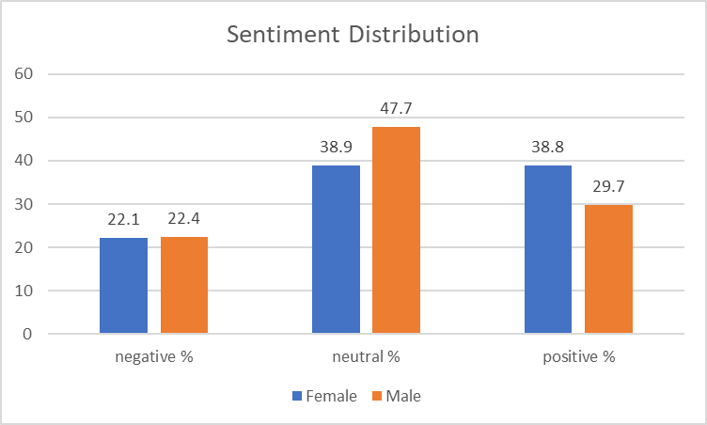
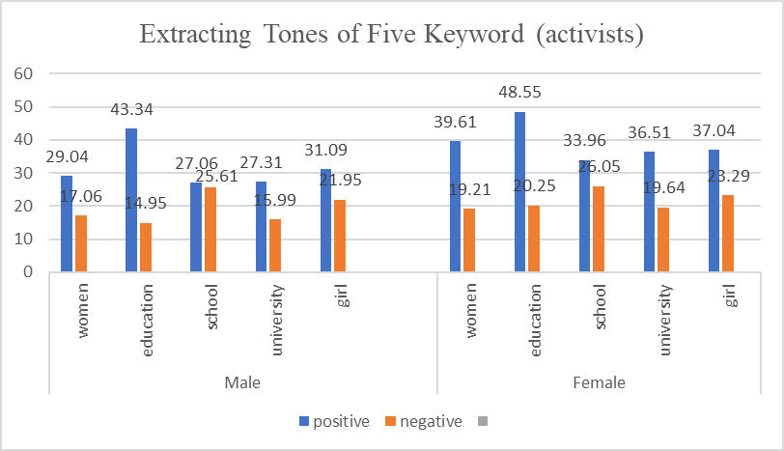
Finding
Implement Sentiment across the dataset
Provide insight
The tone of five keywords on activists
Sentiment Distribution (Activists)
Extracting Tones of Five Keyword (Activists)

Slide 17
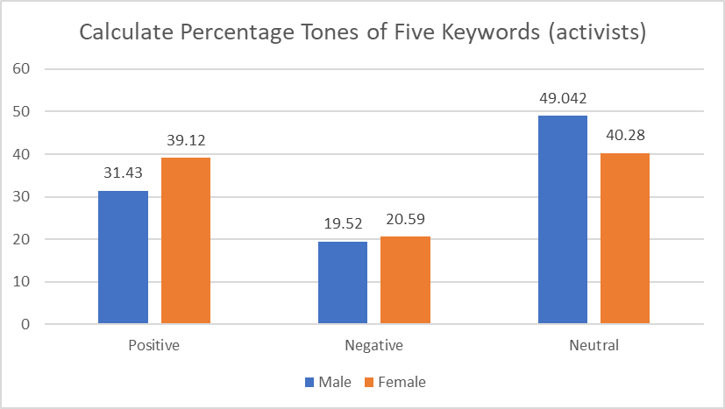
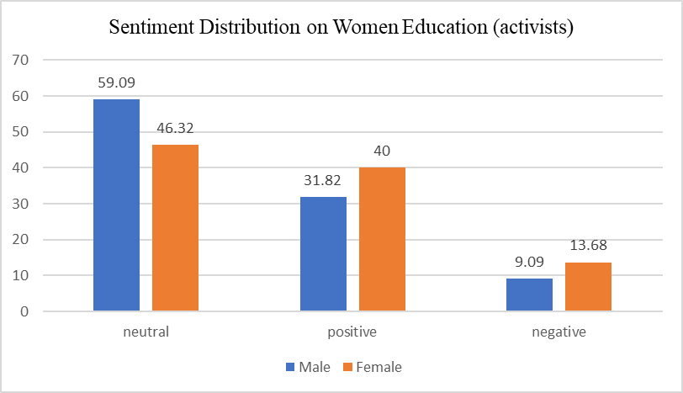
Five Keywords, and 'women education'
Calculating Total Percentage of five keywords
Female has the highest percentage
Calculating the Total Percentage of 'women education' keyword,
Female activists has higher tone
Male are more neutral
Calculate Percentage Tones of Five Keywords (Activists)
Calculate Percentage Tones of Five Keywords (Activists)

Slide 18
Measure five Keywords
For keywords: Women's tweets on education deviate significantly from neutrality (t-statistic: 28.32%, p-value: 1.69%).
Gender | T-Statistic | P-Value
Male | 12.23% | 4.97%
Female | 28.32% | 1.69%
Calculate Sentiment Scores for Five Keywords (Activists)

Slide 19
Measure 'women education'
'Women Education': differ significantly in sentiment expression (males: t-statistic 2.59%, p-value 0.01%; females: t-statistic 3.43%, p-value 0.00%). This underscores the need to consider gender perspectives in discussions about women's education.
Gender | T-Statistic | P-Value
Male | 2.59% | 0.01%
Female | 3.43% | 0.00%
Calculate Sentiment Scores for Women Education (activists)

Slide 20
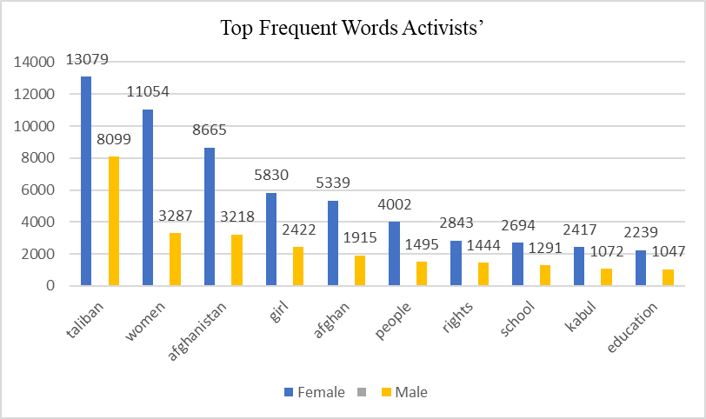
Top and word-cloud words
Top Frequent words, both has the Taliban on top

Slide 21
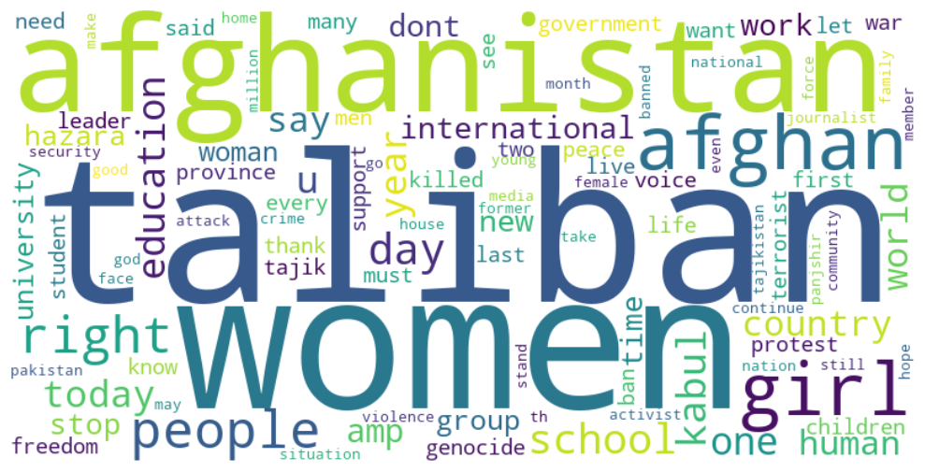
Female Word-Cloud
Mostly talks, women's education,
Human rights
Female Activists Word-Cloud

Slide 22
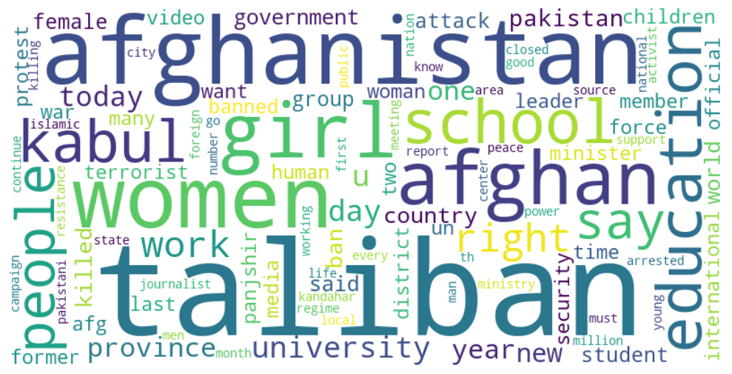
Male Word-Cloud
Mostly talks, women, schools, and the Taliban
Male Activists Word-Cloud

Slide 23
Activists, Logistic Regression
Male 0
Female 1
This finding highlights the critical function of activists in promoting women's education
Optimization terminated successfully.
Current function value: 0.666068
Iterations 4
Logit Regression Results
==========================================================================================
Dep. Variable: label No. Observations: 52246
Model: Logit Df Residuals: 52244
Method: MLE Df Model: 1
Date: Thu, 01 Jun 2023 Pseudo R-squ.: 0.0002533
Time: 20:25:14 Log-Likelihood: -34799.
converged: True LL-Null: -34808.
Covariance Type: nonrobust LLR p-value: 2.681e-05
=============================================================================================
coef std err z P>|z| [0.025 0.975]
---------------------------------------------------------------------------------
const -0.5241 0.016 -33.420 0.000 -0.555 -0.493
Female 0.0803 0.019 4.194 0.000 0.043 0.118
=============================================================================================

Slide 24
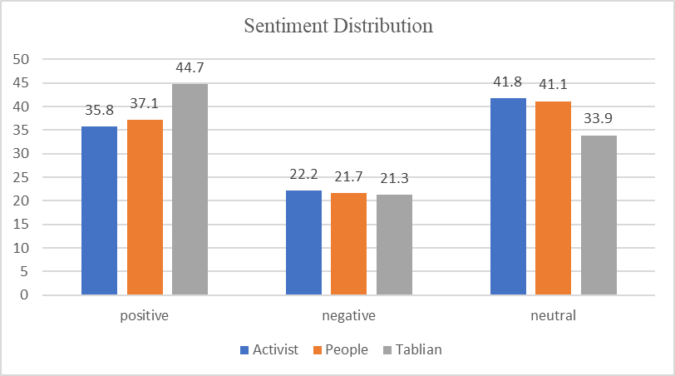
Activists, Taliban and Public
Taliban has higher positive
People also, higher
Activists
Their data also, larger

Slide 25
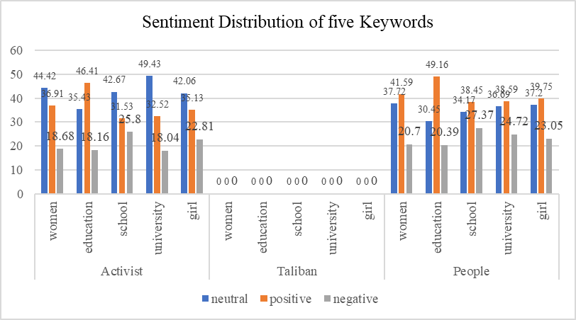
Descriptive Tweets and Sentiment Distribution of Five Keywords
We cannot calculate of five keywords for the Taliban, because its too small compared to activists and the public. And the table shows the Taliban tweets related to five keywords
Tweets Related to Keywords
jobs allocated women educational sector today announced ministry education jobs teachers administrative staff male female states herat farah ghor badghis nangarhar laghman kunar nuristan
many years uzbekistan hijab allowed women educational institutions
public private universities throughout country open men women education process extended percent remaining parts country thousands women education higher education public health id passport offices airports police media

Slide 26
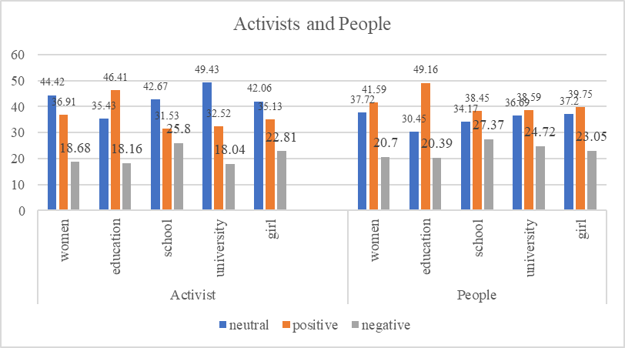
Activists and People
Compare keywords between activists and people. We can see that activists are more likely to be positive compared to people.

Slide 27
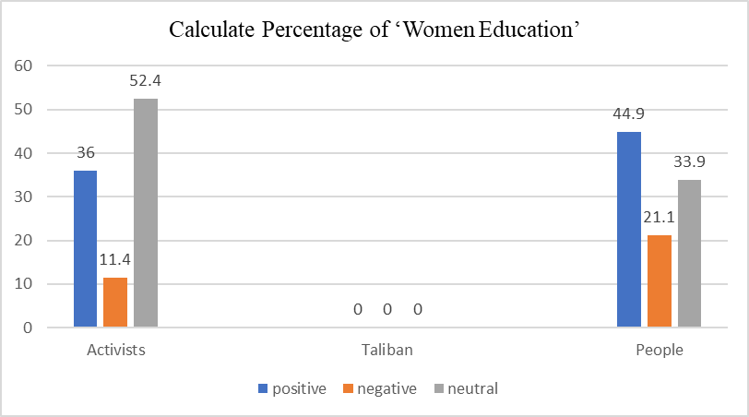
Calculating the Percentage of 'Women education'
Cannot calculate Taliban's percentage,
People are more harsh using 'women education'.
Activists balance their words

Slide 28
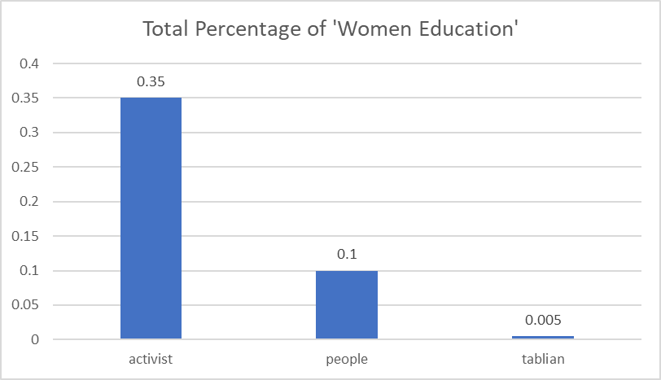
Total Percentage of 'Women Education'
'Women Education' :
Activists, mentioned, 183 (0.35%)
People mentioned, 109 (0.005%)
Taliban mentioned, 4, no percentage

Slide 29
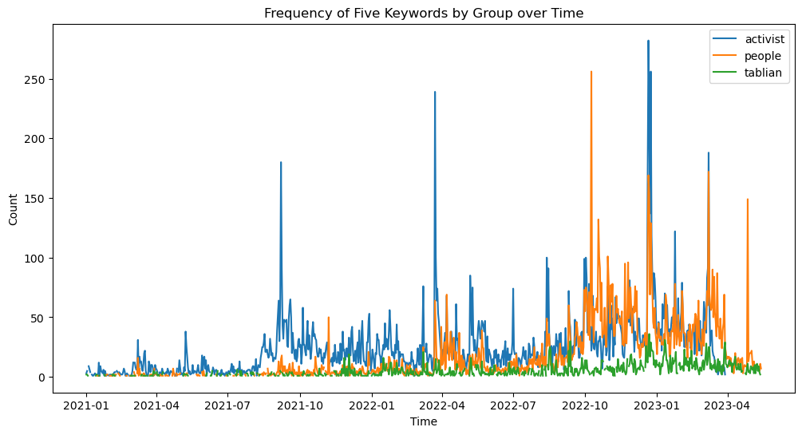
Analyzing Keywords Through Time
Analyzing our five keywords through the year, which group has use more frequently.

Slide 30
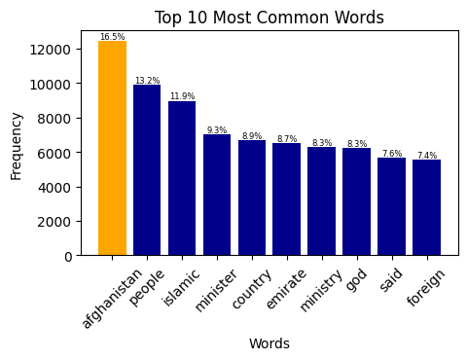
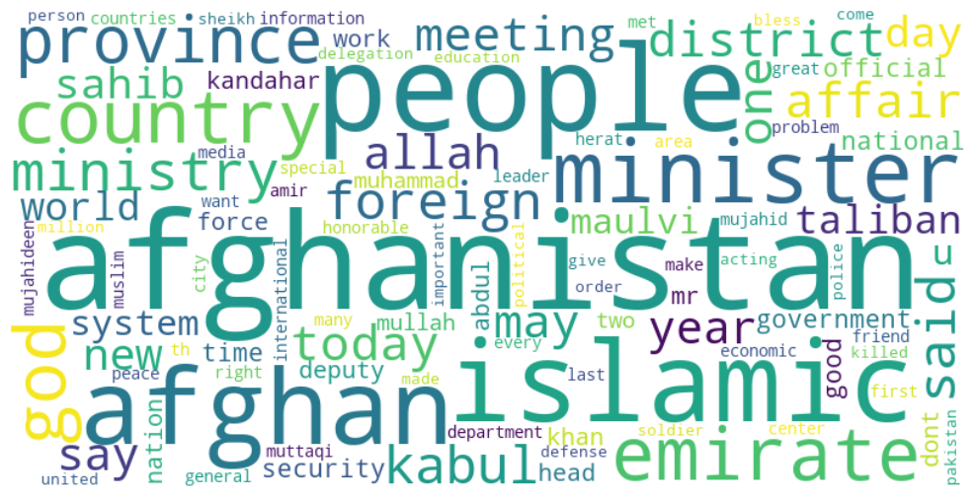
Top Frequent Words and Word-Cloud, Taliban
No tweet regarding women's education
Taliban, has the largest Tweets

Slide 31
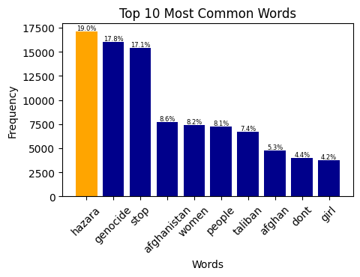
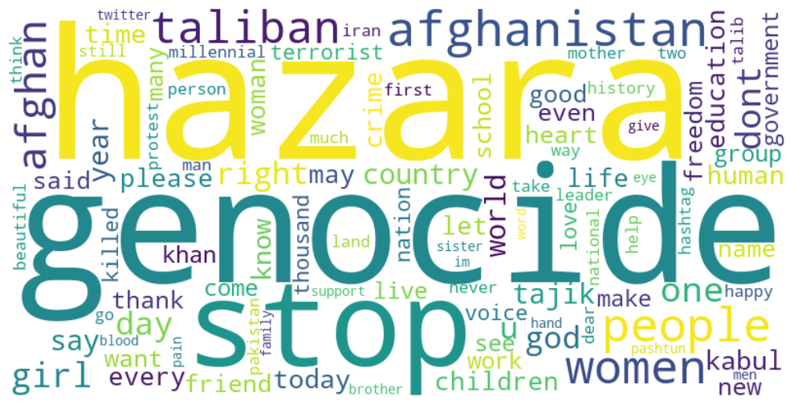
Top Frequent Words and Word-Cloud, Female

Slide 32
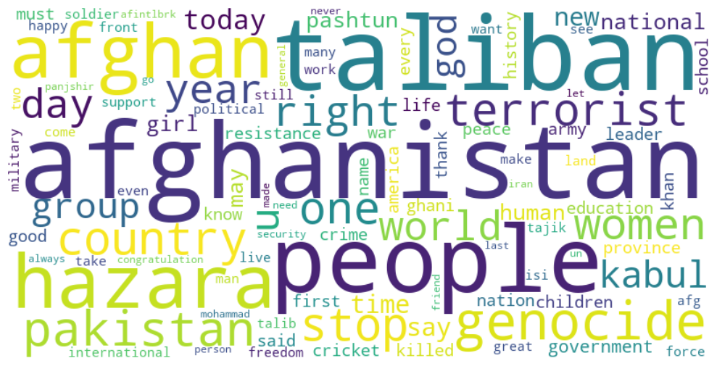
Top Frequent Words and Word-Cloud, Male

Slide 33
Thank You
The discussion on women's education in Afghanistan highlights the divergent perspectives and motivations of different groups. Activists play a crucial role in advocating for education as a means of empowerment and social progress. They recognize the transformative power of education in challenging societal norms, breaking oppressive systems, and contributing to the overall development of communities. On the other hand, the Taliban holds a contrasting view rooted in religious fundamentalism and traditional gender roles. They perceive women's education as a threat to their established order and impose severe limitations on access, hindering progress towards gender equality.
The public's attitudes towards women’s education in Afghanistan are influenced by various factors such as education, religious beliefs, and cultural backgrounds. While some individuals align with the activist perspective and advocate for equal opportunities for women, others may hold reservations or oppose women’s education due to adherence to societal norms and traditional values. This diversity of perspectives adds complexity to the discourse surrounding women’s education in Afghanistan and underscores the need for nuanced approaches to promote education and engage with different segments of society. Understanding and addressing these varying viewpoints is essential in formulating effective strategies and policies that advance women’s education and work towards achieving gender equality in the country.

